Slide 1


ACADEMIC INFORMATION
SYSTEM APPLICATION

Slide 2








OVERVIEW
This system was created to facilitate educational administration activities, all of which are managed online. Some examples of activities that are administrative in nature are new student admissions, preparation of educational schedules, student records, lecturer data recording, attendance, employees, students and filling in grades.
AcademiSys
Academic Information Management System
Databases & Apps
Monitoring
Lecturer
Student
Admin System

Slide 3
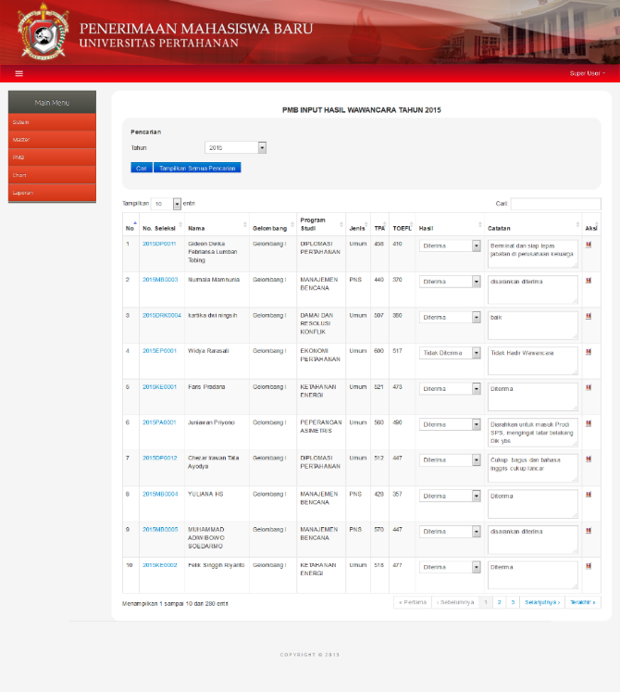
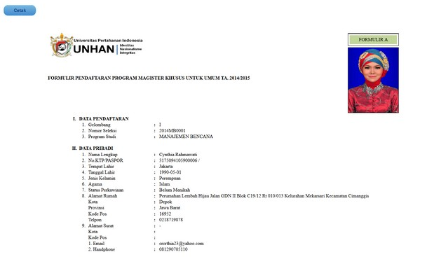
SYSTEM ADVANTAGES
Designed to manage all existing information in an integrated manner, so that the available data is always updated (up to date) in real time
Minimize data duplication encountered in manual systems
Media of communication between students and lecturers
Serves as an information center, among others:
New student Admission
Education schedule
Evaluation
Education Evaluation

Slide 4
FEATURE
Student Data
Lecturer Data
Education Data
Student Grade List
Alumni Data
Absent
Data
Data Evaluasi Dosen

Slide 5
Benefits of Academic Information Systems
Make it easier for students to obtain information without the need to come to the administration section at the education and training center which is often long because they have to queue, etc.
The administration of the education and training center is also facilitated by this system because it reduces the burden of interacting with students who need data. The administration department can focus its time on data input and data checking.
The data is stored in a structured manner with a database stored on a computer.
More effective student administration data processing by using applications that can support staffing processes and processes

